Slide 1
Microsoft Azure Administration | Development
Modul 3 – Microsoft Azure| App Services

Slide 2
Inhalte
Azure App Services
01
Hands OnLab
04
Lab 6.1
Lab 6.2
Web Apps
02
API Apps
03

Slide 3
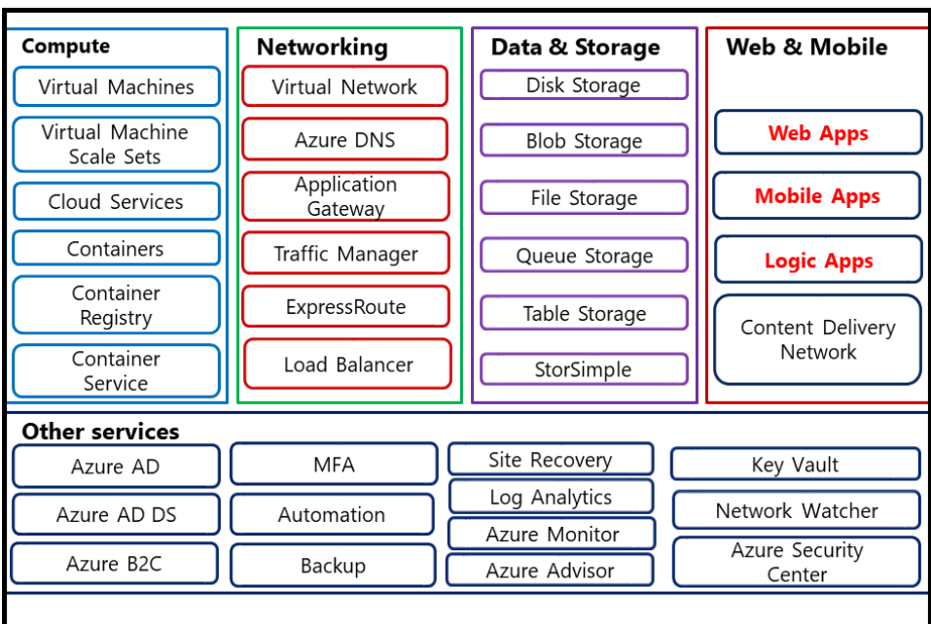
Azure App Services

Slide 4
Azure App Services
Sind eine Ausführungsplatform für:
Web Apps
API Apps
Logic Apps

Slide 5
Aufbau
App Service Plan
Web App 1
Mobile App 1
Function App 1

Slide 6
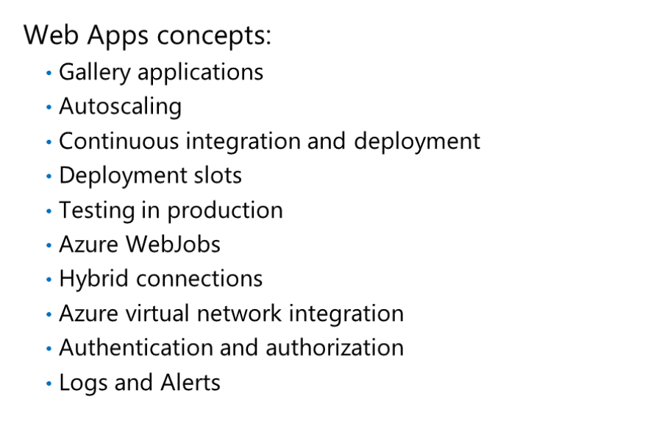
Azure Web Apps

Slide 7
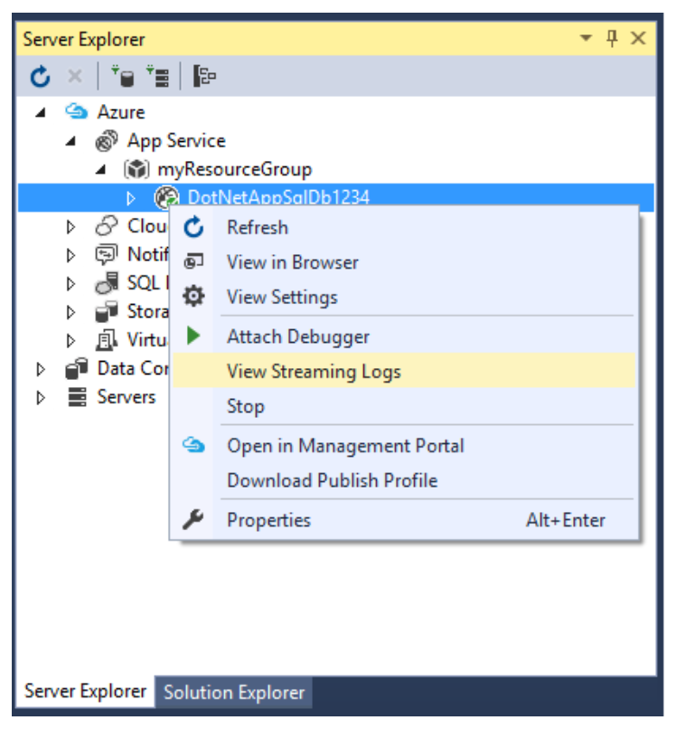
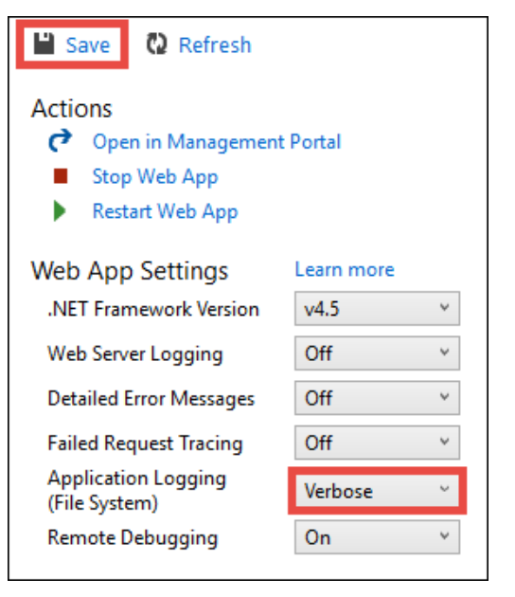
Log Streaming
Trace.WriteLine() | Trace.WriteError()

Slide 8
DEMO: Web Apps
Notes:
Portal
Powershell / CLI

Slide 9
Lab 3.1 Deployment von Web Apps
Notes:
Portal
Powershell / CLI

Slide 10
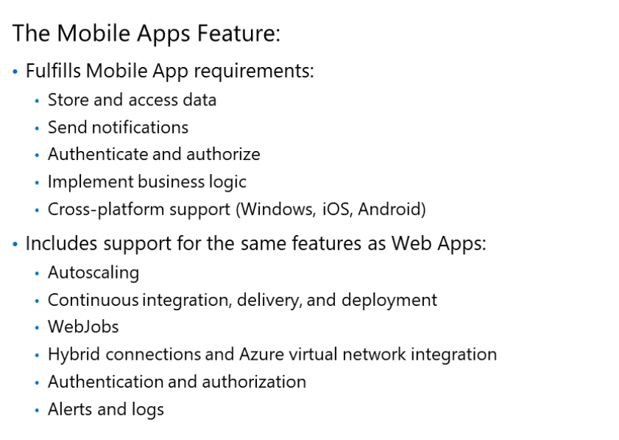
Azure Mobile Apps

Slide 11
Azure Mobile Apps

Slide 12
DEMO: Mobile Apps

Slide 13
Lab 3.2 Deployment von Mobile Apps
Notes:
Portal
Powershell / CLI

Slide 14
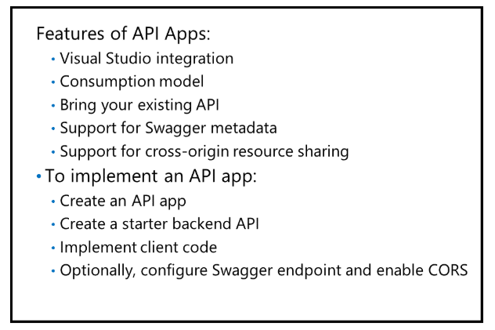
Azure API Apps

Slide 15
DEMO: API Apps

Slide 16
Lab 3.3 Deployment von API Apps

Slide 17
Fragen?

